Slide 1


Unit 2: Lesson 5
Goosebumps, anybody?

Slide 2


Slide 3
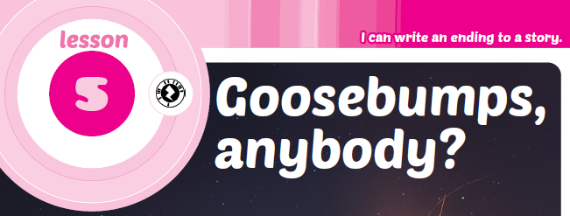
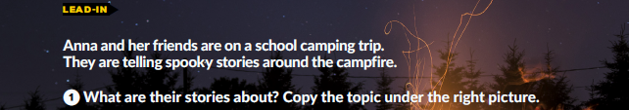
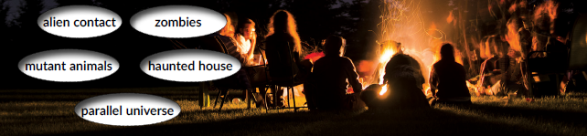


mutant animals
parallel universe
zombies
alien contacts
haunted house

Slide 4
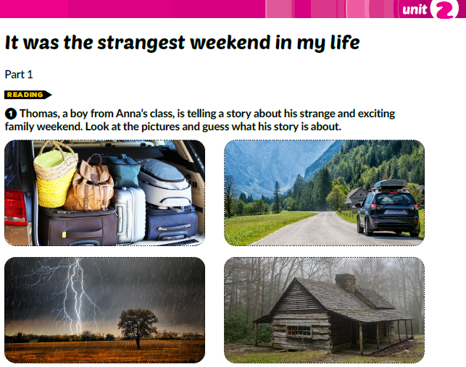

Slide 5
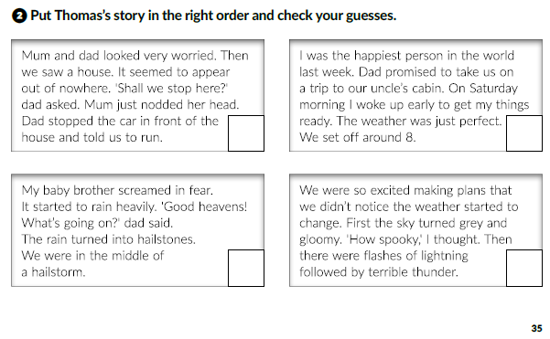
4
1
3
2

Slide 6
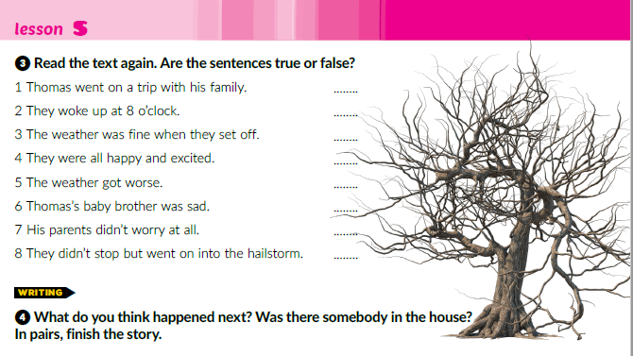
T
F
T
1
1
T
T
F
F
F

Slide 7
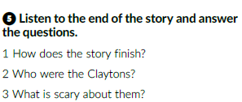
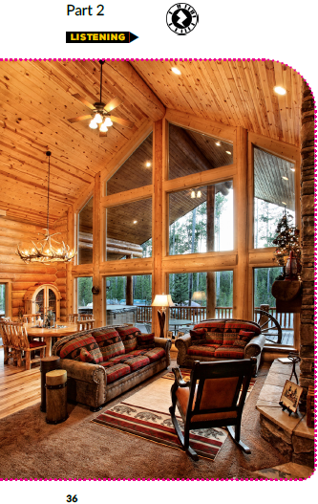
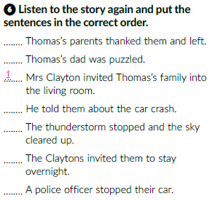
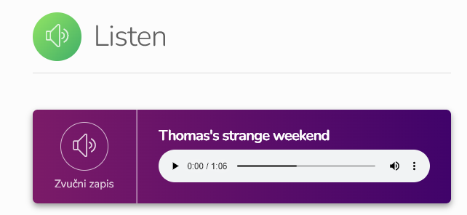

4
7
6
2
https://www.e-sfera.hr/dodatni-digitalni-sadrzaji/ea48000b-13d4-4757-8311-4072a5fddc55/
3
5

Slide 8
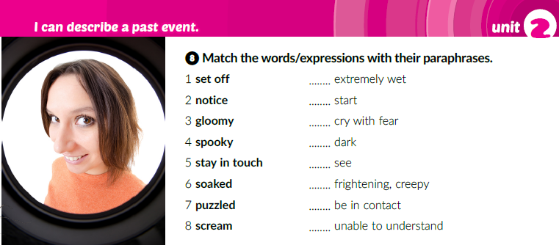
6
1
8
3
2
4
5
7

Slide 9
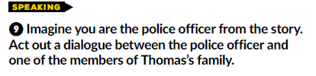
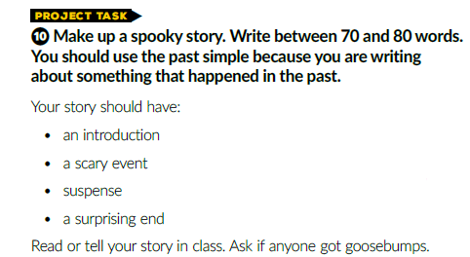
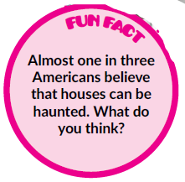

Slide 10
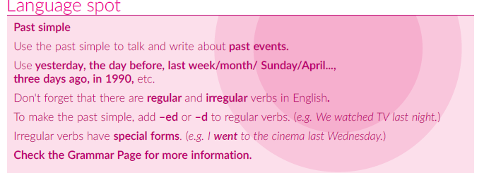

Slide 11
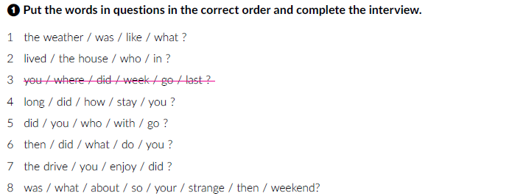
workbook p. 20
What was the weather like?
Who lived in the house?
Where did you go last week?
How long did you stay?
Who did you go with?
What did you do then?
Did you enjoy the drive?
What was then so strange about your weekend?

Slide 12
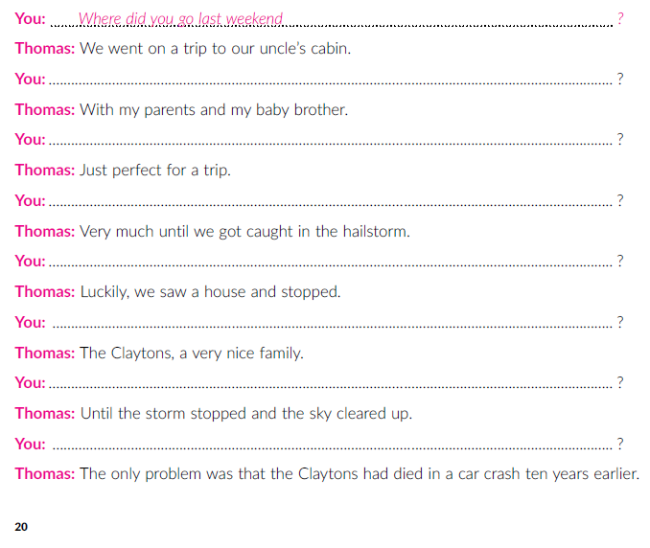
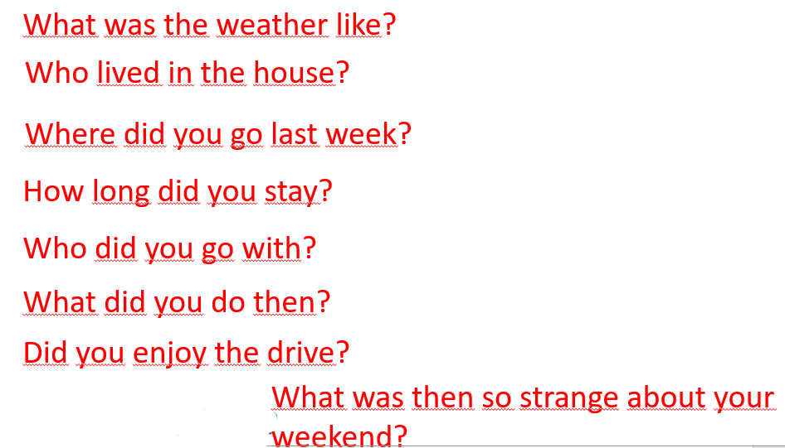
Complete the interview.
Who did you go with?
What was the weather like?
Did you enjoy the drive?
What did you do then?
Who lived in the house?
How long did you stay?
What was then so strange about your weekend?

Slide 13
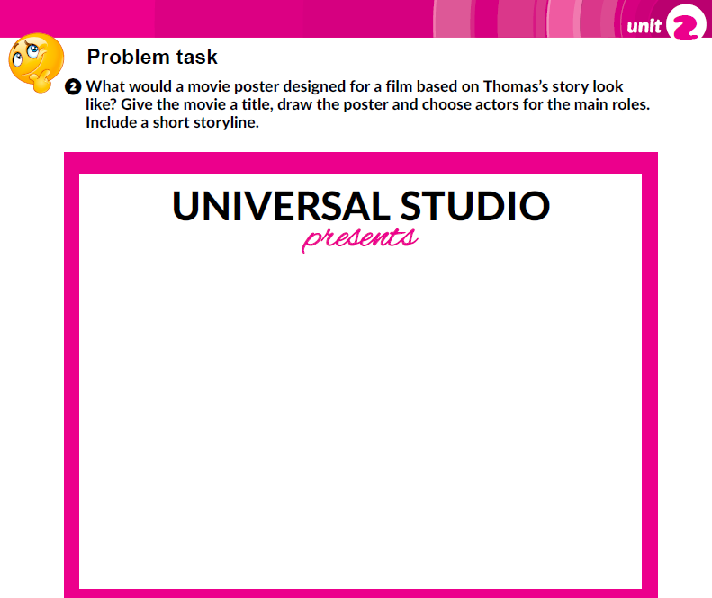
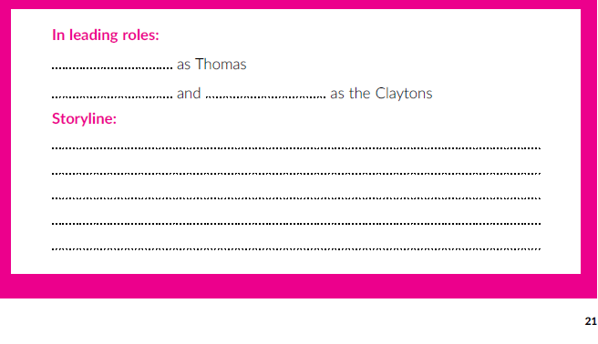

Slide 14
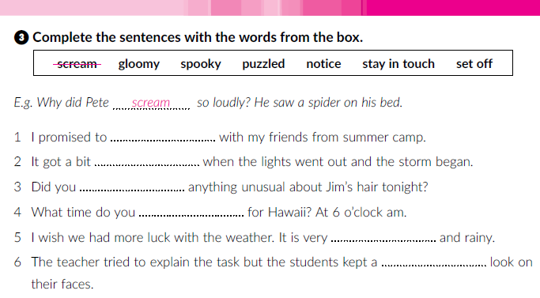
stay in touch
spooky
notice
set off
gloomy
puzzled

Slide 15
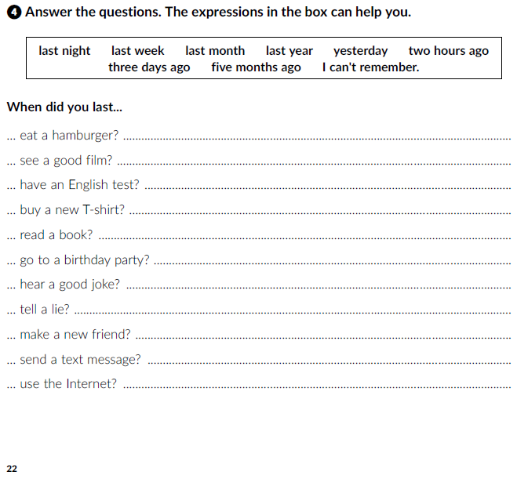

Slide 16
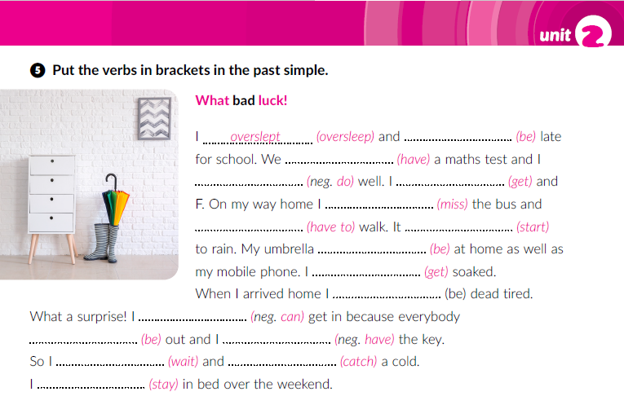
was
had
didn’t do
got
missed
had to
started
was
got
was
couldn’t
was
didn’t have
waited
caught
stayed

Slide 17
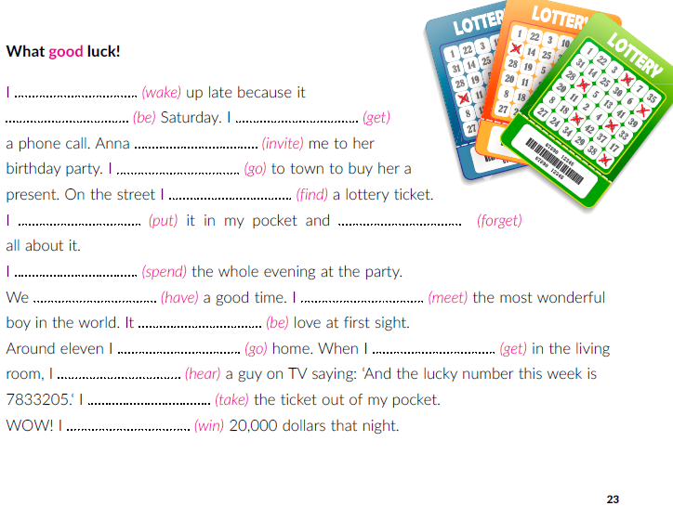
woke
was
got
invited
went
found
put
forgot
spent
had
met
was
went
got
heard
took
won

Slide 18

PLAY AND LEARN
https://www.e-sfera.hr/dodatni-digitalni-sadrzaji/ea48000b-13d4-4757-8311-4072a5fddc55/

